Slide 1
Product Review Rating Using NLP
Submitted by:
Arshi Maitra

Slide 2
Acknowledgement:
This project has been completed with the help of training documents and live classes recordings from Data Trained Education. Few help on coding have also been taken from few data science websites like Toward Data Science, Geek for Geeks, Stack Overflow. All data related to product rating has been taken from FlipKart under Headphones, Camera, Speakers, Mobiles, Iphone and TV. I would also like to extend my gratitude to the FlipRobo team who have given me this wonderful opportunity to work on this amazing dataset.

Slide 3
INTRODUCTION
Machine Learning (ML) is a field of Artificial Intelligence where data-driven algorithms learn patterns by getting exposed to relevant data. ML has gained massive importance in the field of Natural Language Processing (NLP), i.e. interpreting human language. In this article, we will focus on the use of both ML and NLP in predicting the ratings of user reviews.
We have a client who has a website where people write different reviews for technical products. Now they are adding a new feature to their website i.e. The reviewer will have to add stars(rating) as well with the review. The rating is out 5 stars and it only has 5 options available 1 star, 2 stars, 3 stars, 4 stars, 5 stars. Now they want to predict ratings for the reviews which were written in the past and they don’t have a rating.
Therefore the main goal of this project is to determine the following:
⦁ To predict the rating of the product by looking at their review
The following data has been taken from flipkart.com. Here the ratings of various electronic products have been scraped around 22,000. We will be trying to analyze the pattern of words as well as the ratings prediction from the scraped dataset.

Slide 4
Analytical Problem Framing

Slide 5
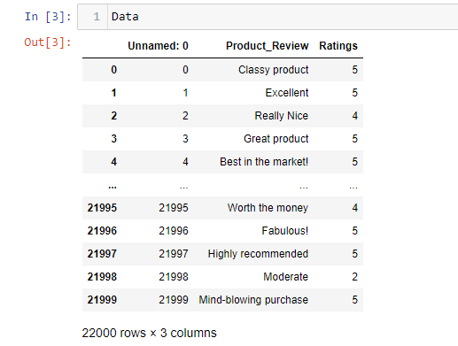
Web Scraping
Before importing the necessary libraries for data analysis and prediction, the data has been first scrapped from the website www.flipkart.com by using the Selenium method from Web Scraping. The data is saved in CSV which is later on used for analysis:

Slide 6
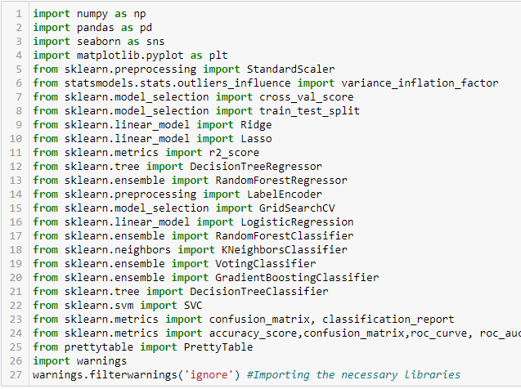
Importing Necessary Libraries
ML:

Slide 7
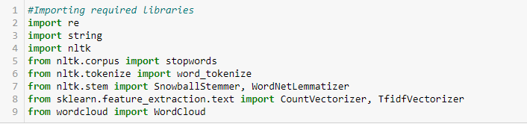
NLP

Slide 8
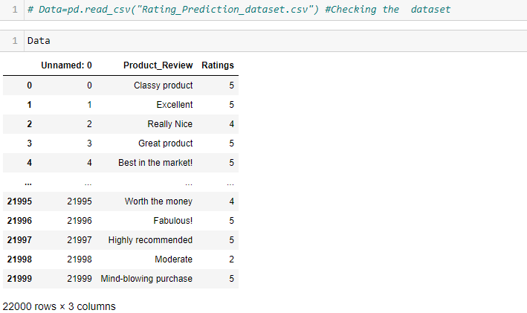
Data preprocessing/Data Cleaning:
Loading the dataset

Slide 9
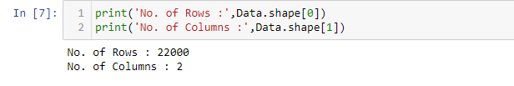
Checking the rows and columns

Slide 10

Checking the null values from the data:
Dropping the unnecessary column:

Slide 11
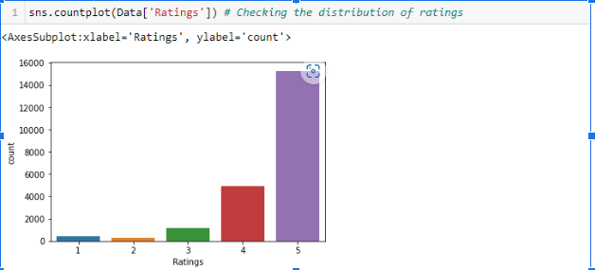
Visualization:
Checking Rating Distribution:

Slide 12
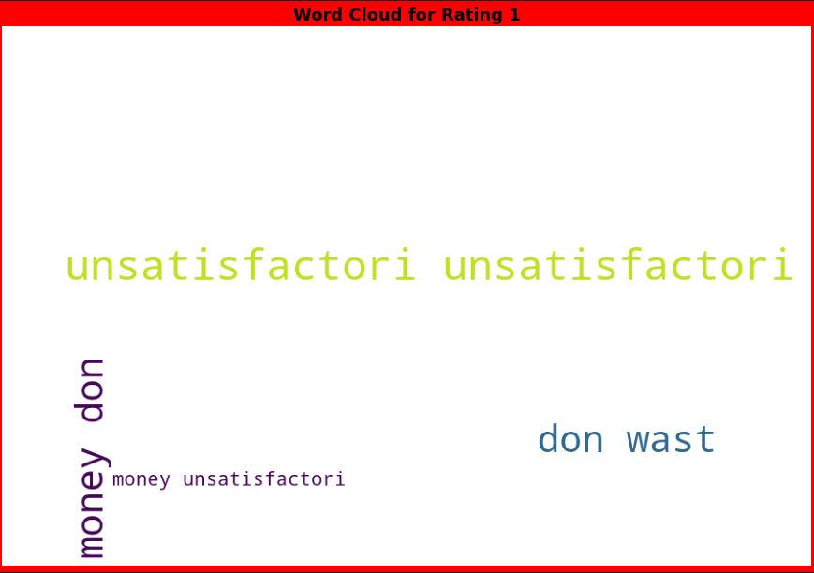
WordCloud:

Slide 13
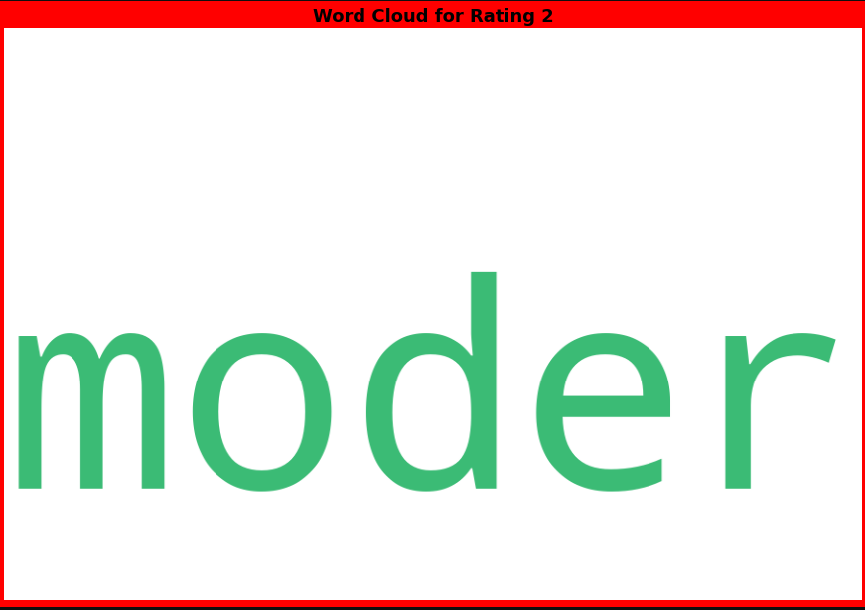

Slide 14
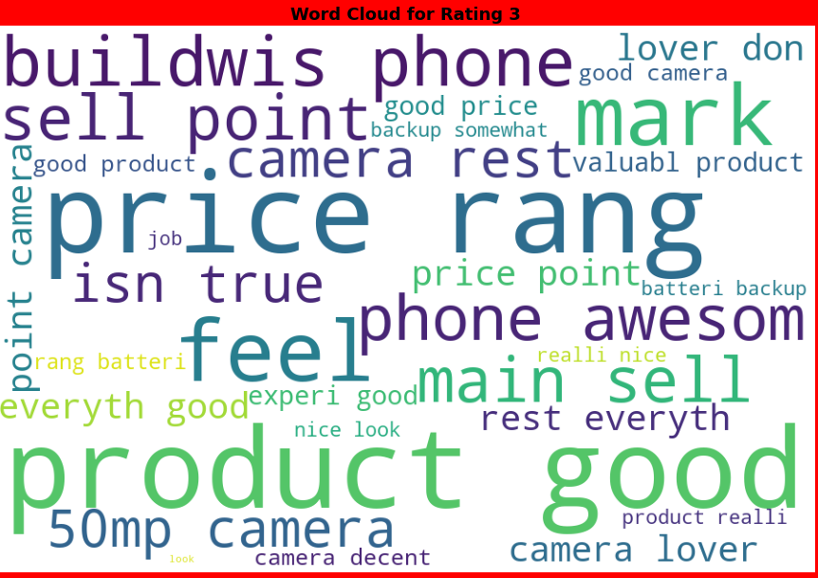

Slide 15
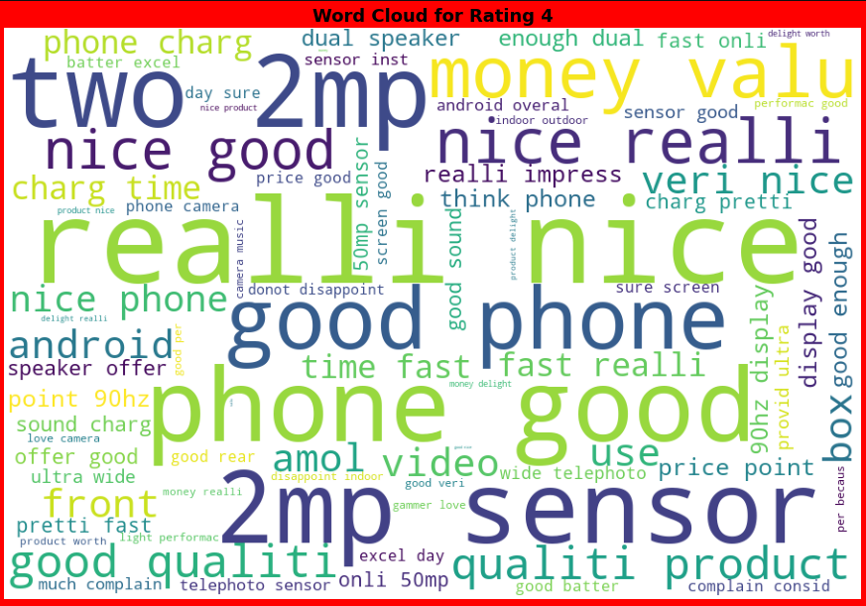

Slide 16
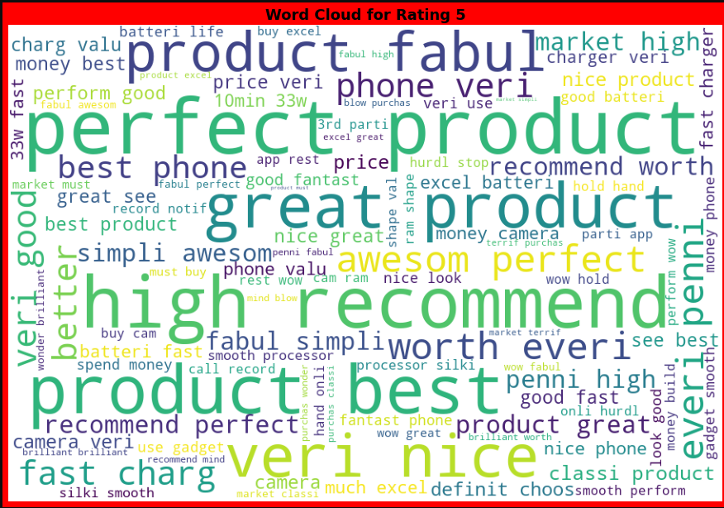

Slide 17
Model/s Development and Evaluation
(Logistic Regression, Decision Tree Classifier, Random Forest Classifier)

Slide 18
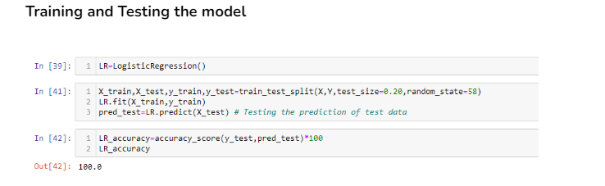
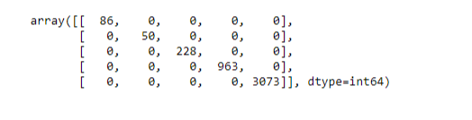
Logistic Regression
Confusion Matrix

Slide 19
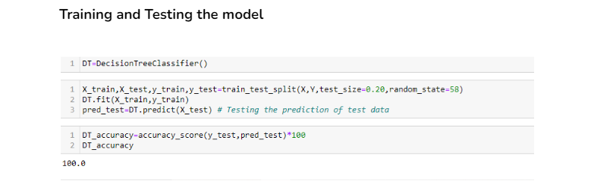
Decision Tree Classifier
Confusion Matrix

Slide 20
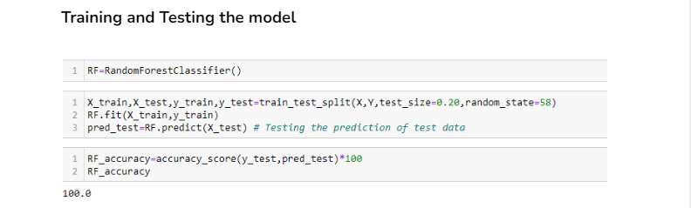
Random Forest Classifier
Confusion Matrix

Slide 21
Hyperparameter Tuning:
As all the scores came down to 100%, hence the hypertuning parameter is not performed. Random Forest Classifier is chosen since It is based on the concept of ensemble learning, which is a process of combining multiple classifiers to solve a complex problem and to improve the performance of the model.

Slide 22
Conclusion

Slide 23
Learning Outcomes:
Hands on chance to enhance web scraping skills
In this project, I was able to learn various NLP techniques like Stemming, Lemmatization and removal of stop words.
This project has stressed the importance of sampling, modeling and predicting data.
Limitations:
More input features could be scraped.
There is scope for application of advance deep learning NLP tool.

Slide 24
Thank You!

